Slide 1

Predicting customer buying behavior
SHAKEB HASSAN SHAMSI

Slide 2
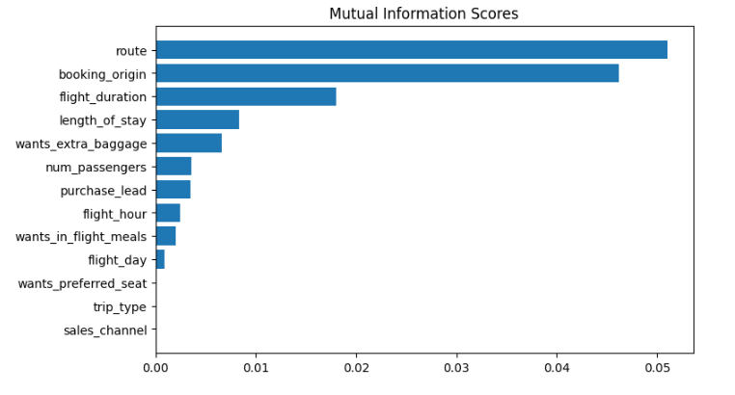
predictive model to understand factors that influence buying behavior
We have trained the data set with Random forest classifier model and received
Top 5 features which influence Customers buying behavior
route
booking origin
flight duration
wants_extra_baggage
length_of_stay
ACCURACY: 85.09 AUC score: 0.558
We need to increase the AUC score.

